Slide 1


Efficient Approximate Maximum Inner Product Search over Sparse Vectors
Xi Zhao¹, Zhonghan Chen¹, Kai Huang², Ruiyuan Zhang¹, Bolong Zheng³,Xiaofang Zhou¹
¹Hong Kong University of Science and Technology
²Macau University of Science and Technology
³Huazhong University of Science and Technology
ICDE 2024
Notes:
Hi, everyone! It is my great honor to share my research here. My name is Xi Zhao, from the Hong Kong University o. Today, I will be presenting my work in the field of high-dimensional vector search, which is named ….

Slide 2
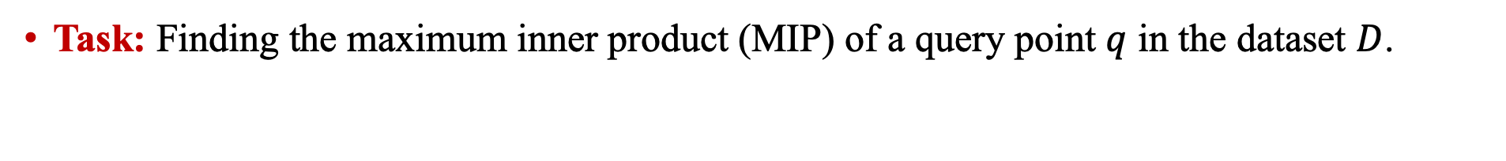
Maximum Inner Product Search in High-D Spaces
Task: Finding the maximum inner product (MIP) of a query point $q$ in the dataset $D$.
Applications: Multi-Model Search; Retrieval-augmented generation (RAG)
Challenges:
Brute-force method: exhaustive/linear search + sorting
Most indexes suffer from the phenomenon of “curse of dimensionality”
Cost is too high!
Approximate answer should suffice AMIPS
Notes:
The maximum inner product search is to find the point that has the maximum inner product to a given query point q.
As a kind of vector similarity search, this problem is widely used in many machine learning tasks, such as multi-model search and RAG. For example, in the multi-model search, we want to find some images by using a text as questions. In this way, we should find a unified representation for the texts and images. The vector is a good choice for representing them. Then, we can answer this multi-model search problem in the vector space.
When the data dimensionality of the dataset D is very high, due to the curse of dimensionality, there is no index that can help us answer the MIPS problem efficiently. So, it is a better choice to find an approximate result.

Slide 3
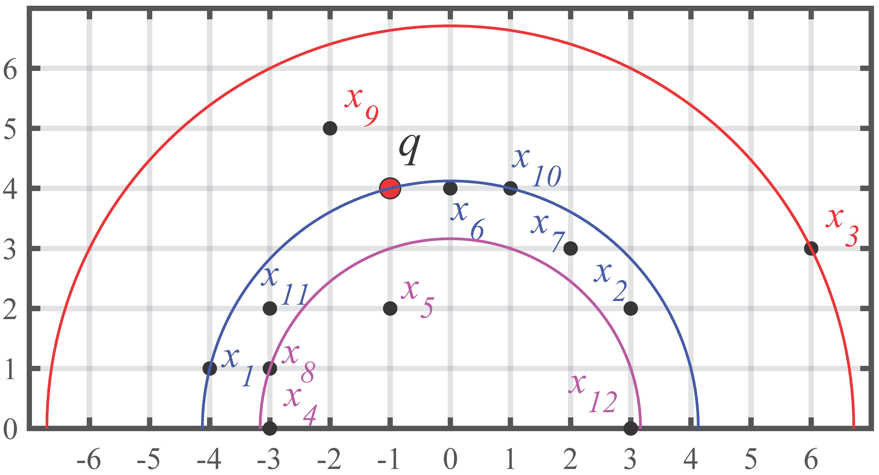
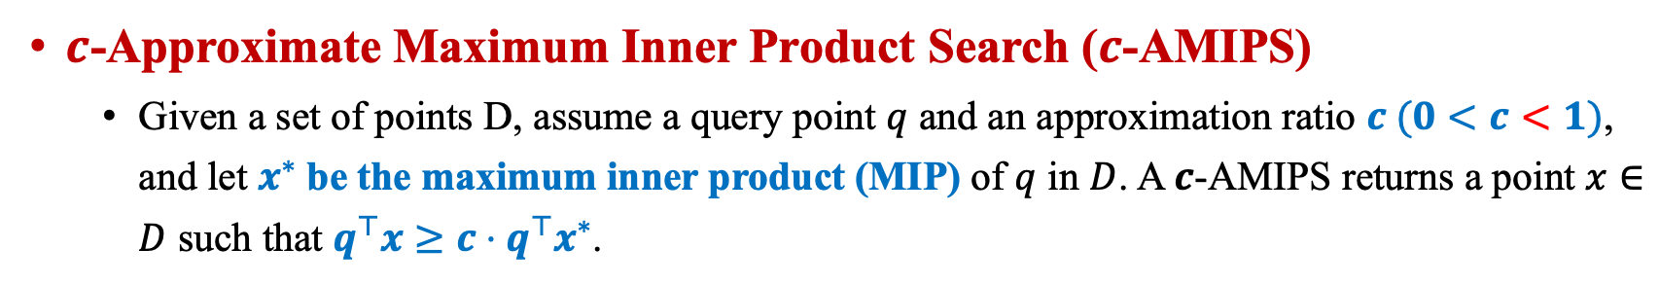
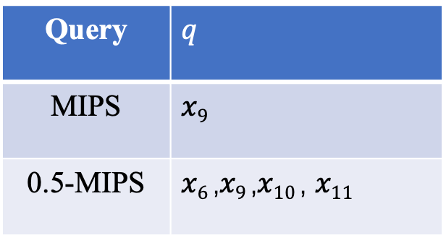
Problem Definition
$c$-Approximate Maximum Inner Product Search ($c$-AMIPS)
Given a set of points D, assume a query point $q$ and an approximation ratio $c (0<c<1)$, and let $x^{∗}$ be the maximum inner product (MIP) of $q$ in $D$. A 𝒄-AMIPS returns a point $x∈D$ such that $q^{⊤}x≥c⋅q^{⊤}x^{∗}$.
Query | $$q$$
MIPS | $$x9$$
0.5-MIPS | $x6$,$x9$,$x10$, $x11$
Notes:
The approximate version of MIPS problem we want to answer is called as the c-Maximum Inner Product search, i.e., c-AMIPS search, which is defined as follows.
In this example, x_9 is the maximum inner product result with q whose inner product to q is 2+20=22. For a 0.5-MIPS, a point whose inner product to q is greater than 11 can be returned, such as 𝑥6 ,𝑥9 ,𝑥10 , 𝑥11.

Slide 4
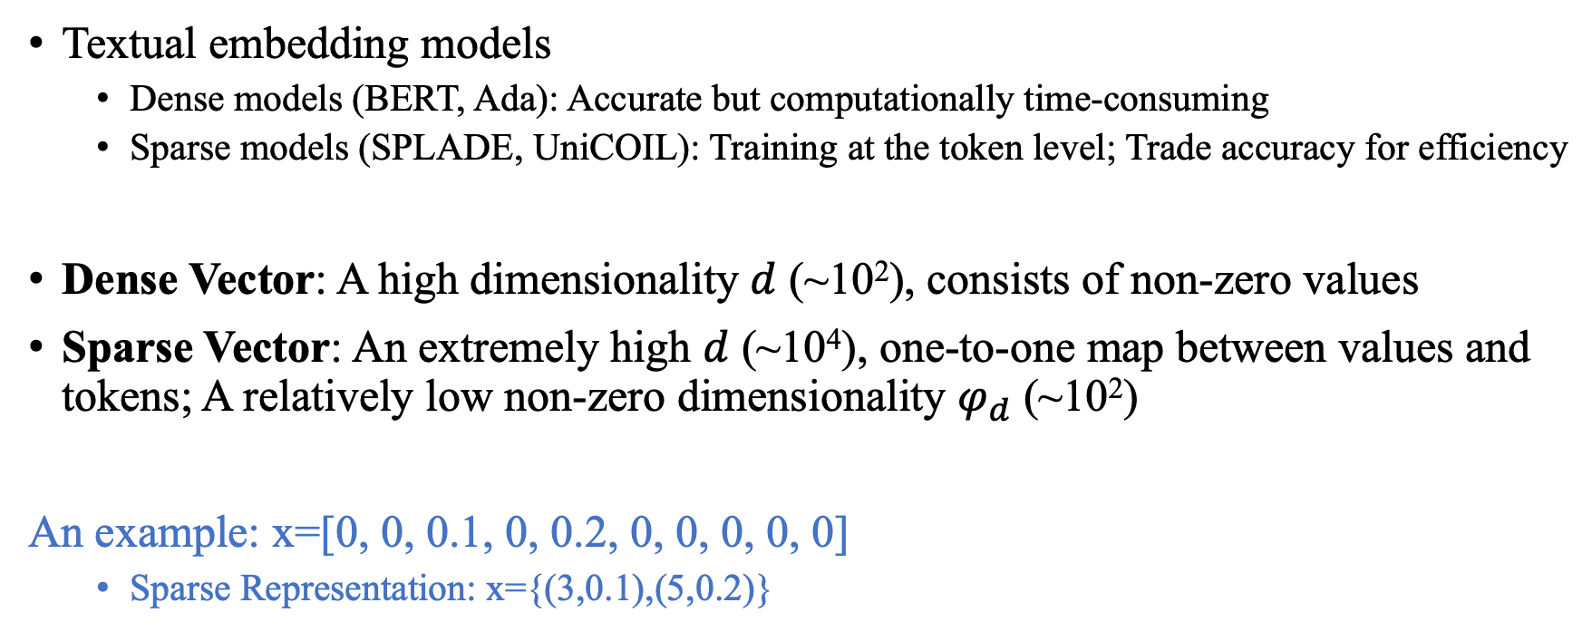
MIPS over Sparse Vector & Dense Vector
Textual embedding models
Dense models (BERT, Ada): Accurate but computationally time-consuming
Sparse models (SPLADE, UniCOIL): Training at the token level; Trade accuracy for efficiency
Dense Vector: A high dimensionality $d$ (~10²), consists of non-zero values
Sparse Vector: An extremely high $d$ (~10⁴), one-to-one map between values and tokens; A relatively low non-zero dimensionality $φ_{d}$ (~10²)
An example: x=[0, 0, 0.1, 0, 0.2, 0, 0, 0, 0, 0]
Sparse Representation: x={(3,0.1),(5,0.2)}
Notes:
The vectors are obtained from many embedding models. In NLP tasks,
The common textual embedding model, such as BERT, outputs dense vectors. So, they are called as dense models. Their embedding results has a good performance in NLP tasks. However, it is time-consuming to train it because these models require finding nearest neighbors during the training processing.
The sparse models, such as SPLADE, trains the texts at the token level and output the sparse vectors as the embedding results, which are also widely used due to its low training costs.
Compared to the dense vectors, sparse vectors have a much higher dimensionality but only a few of them are non-zero values.
This is an example of a sparse vector whose d is 10 but phi_d is only 2.So, we can represent this vector as a set of indice-value pairs. The pair (3,0.1) means the third position in x is 0.1.

Slide 5
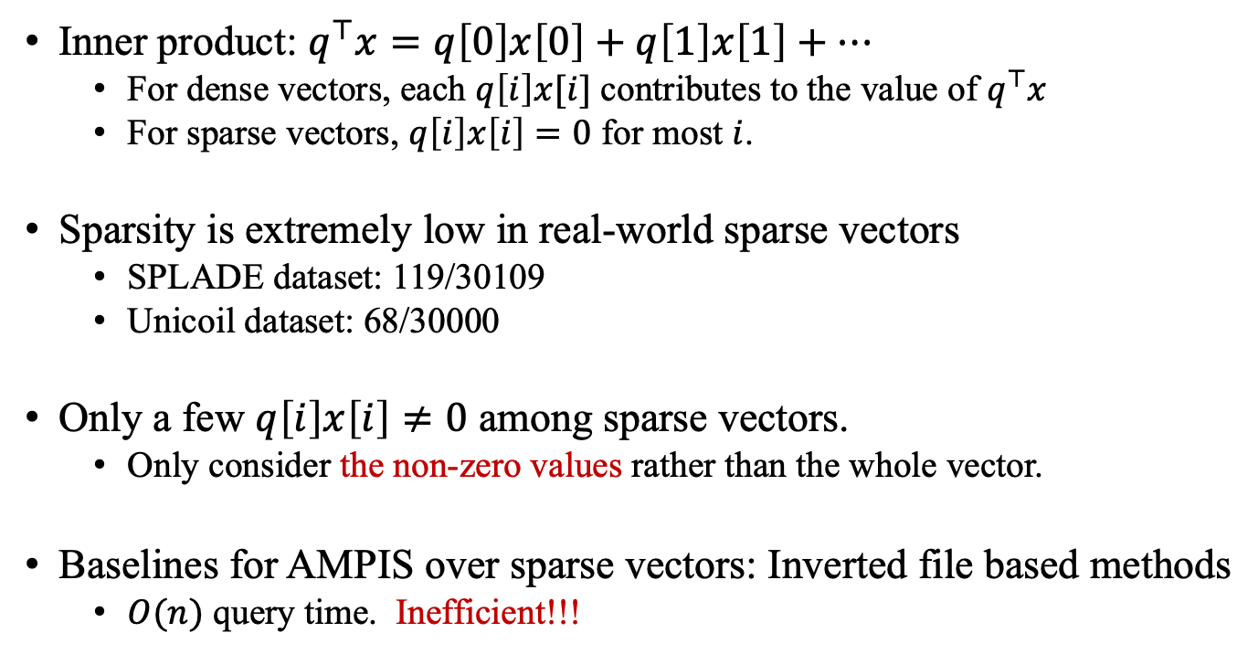
Challenges over Sparse Vector
Inner product: $q^{⊤}x=q\left[0\right]x\left[0\right]+q\left[1\right]x\left[1\right]+⋯$
For dense vectors, each $q\left[i\right]x[i]$ contributes to the value of $q^{⊤}x$
For sparse vectors, $q\left[i\right]x\left[i\right]=0$ for most $i$.
Sparsity is extremely low in real-world sparse vectors
SPLADE dataset: 119/30109
Unicoil dataset: 68/30000
Only a few $q\left[i\right]x\left[i\right]≠0$ among sparse vectors.
Only consider the non-zero values rather than the whole vector.
Baselines for AMPIS over sparse vectors: Inverted file based methods
$O(n)$ query time. Inefficient!!!
Notes:
To compute the inner product of two vectors q and x.
When q and x are dense vectors, each product q[i]x[i] will contribute to the value of their inner product.
However, when these two vectors are sparse vectors, most product q[i]x[i] will be zero because the sparse vectors have many zero values.
For real-world sparse vector, the sparsity, which refers to the ratio of non-zero values, is very low. So, when consider the MIPS problem over sparse vectors, we can only con sider their non-zero values rather than the whole vector.
So, the baselines of AMIPS problem over sparse vectors is using inverted file. It is simple but has a very high query cost.

Slide 6
Our Method-- SOSIA
Notes:
Based on the above observation, we propose a method named SOSIA to answer AMIPS problem over sparse vectors. Let take this figure to illustrate the SOSIA framework.
Firstly, SOSIA employs the SOS transformation to convert points in the sparse dataset into binary vectors. A binary vector is a vector whose values are either 0 or 1. As shown in the medium part of the figure. In this part, each cell presents a value in a vector. And the black cell means the value of 1 and the white cell means the value of 0.
Here, we have 4 points in the dataset with dimensionality 5. Then, we convert each of them into a 15 dimensional binary vector. The blue point x=(0,0.5,0,0,0) is converted to be
a binary vector whose fourth-dimension and sixth-dimension is 1 and the rest entries is 0.
Then, These binary vectors are considered as sets. For example, the third binary vector can be regarded as a set whose element is (4,6).
In this way, the MIPS problem over sparse vectors can be transformed into the set similarity problem.
AS minHash is widely used for solving approximate set similarity problem. We adopt minHash to solve our problem in the following steps.

Slide 7
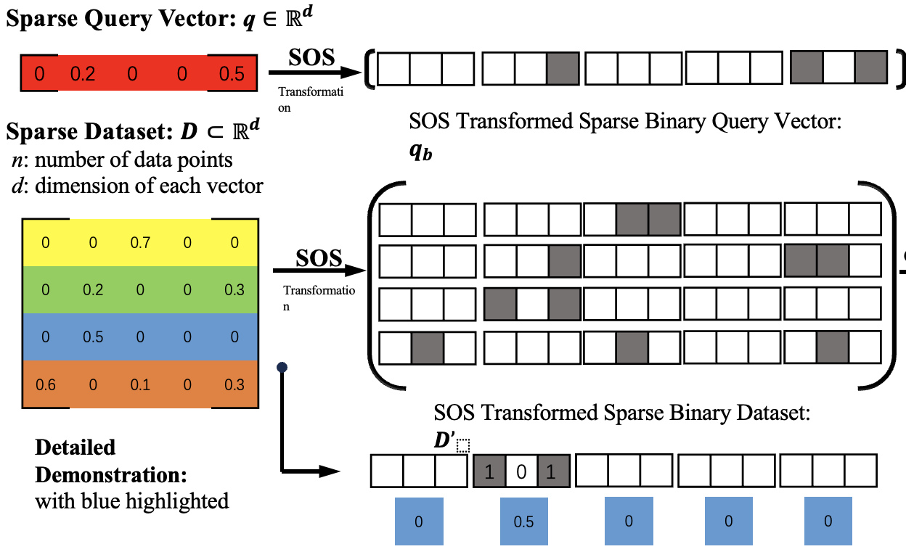
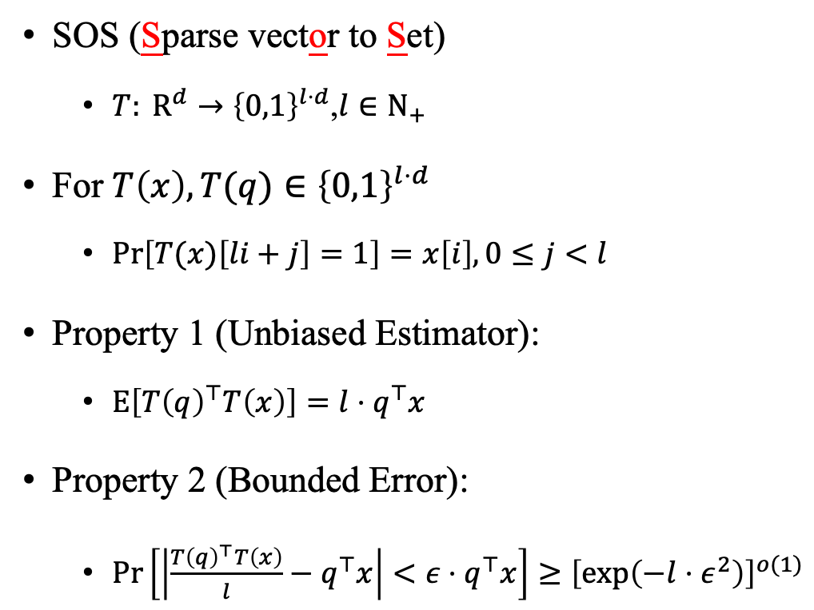
SOS Transformation
SOS (Sparse vector to Set)
${T: R}^{d}→{\left\{0,1\right\}}^{l⋅d}$,$l∈N_{+}$
For $T\left(x\right),T(q)∈{\left\{0,1\right\}}^{l⋅d}$
$Pr\left[T(x)\left[li+j\right]=1\right]=x\left[i\right],0≤j<l$
Property 1 (Unbiased Estimator):
$E\left[T{\left(q\right)}^{⊤}T\left(x\right)\right]=l⋅q^{⊤}x$
Property 2 (Bounded Error):
$Pr\left[\left|\frac{T{\left(q\right)}^{⊤}T\left(x\right)}{l}−q^{⊤}x\right|<ε⋅q^{⊤}x\right]≥{\left[exp\left(−l⋅ε^{2}\right)\right]}^{o(1)}$
Notes:
So, the key part in our method SOSIA is the SOS transformation. To design a transformation that convert a MIPS problem into a set similarity problem, the most important thing is to ensure the found results of the set similarity problem is similar as the results of the original MIPS problem. In the other word, if a point x is the maximum inner product result of the query point q. Then, after transformation, x should have a large set similarity with q. To guarantee this condition, we design the SOS transformation to ensure that: for any two points x and q, their inner product in the transformed space is an unbiased estimator of their original space.
Somehow, This is the most important part of the SOS transform.

Slide 8
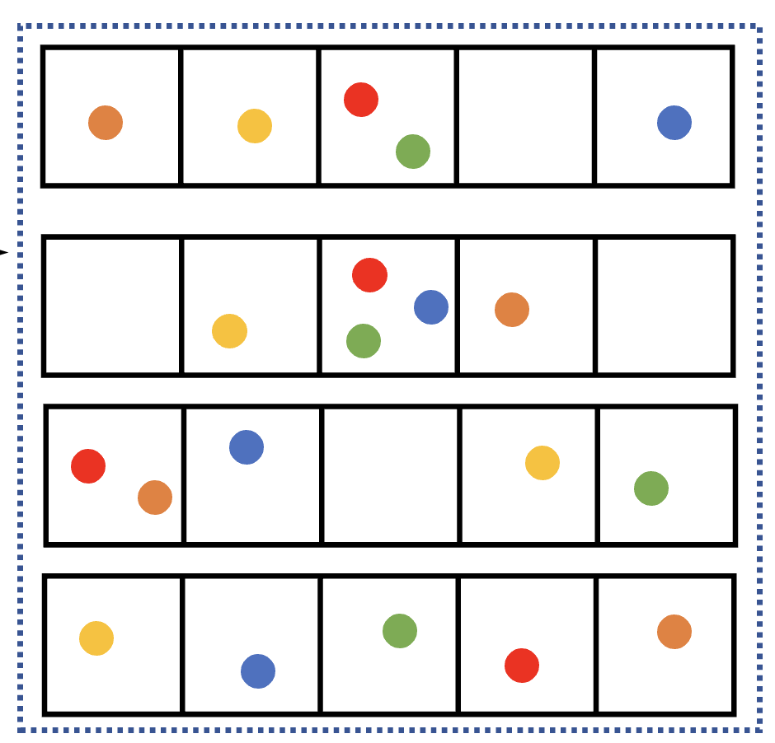
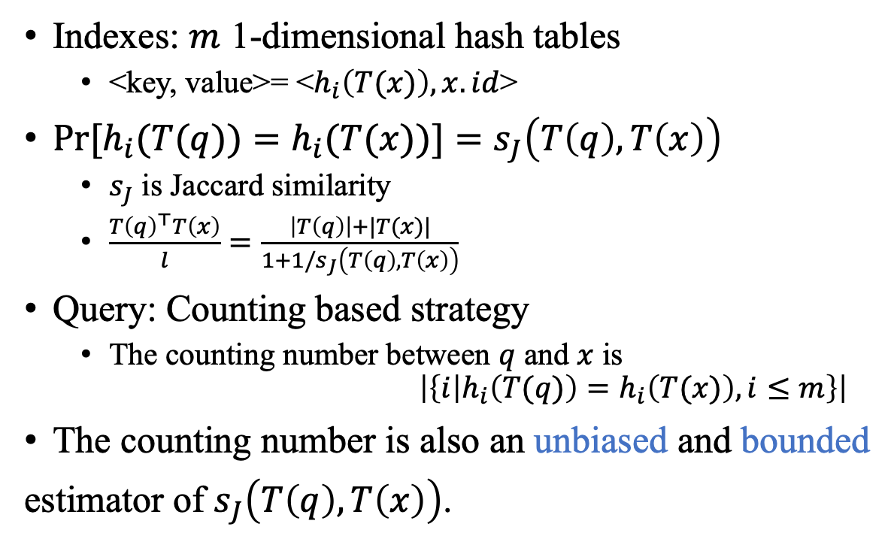
Indexing and Query
Indexes: $m$ 1-dimensional hash tables
<key, value>= <$h_{i}\left(T(x)\right),x.id$>
$Pr[h_{i}(T(q))=h_{i}(T(x))]=s_{J}\left(T\left(q\right),T\left(x\right)\right)$
$s_{J}$ is Jaccard similarity
$\frac{T{\left(q\right)}^{⊤}T\left(x\right)}{l}=\frac{\left|T\left(q\right)\right|+|T(x)|}{1+1/s_{J}\left(T\left(q\right),T\left(x\right)\right)}$
Query: Counting based strategy
The counting number between $q$ and $x$ is
$$\left|\left\{i | h_{i}\left(T(q)\right)=h_{i}\left(T(x)\right),i≤m\right\}\right|$$
The counting number is also an unbiased and bounded
estimator of $s_{J}\left(T\left(q\right),T\left(x\right)\right)$.
Notes:
The index of SOSIA is based on the minHash and LSH, i.e, locality sensitive hashing. However, different from the traditional minHash indexes, we proposed a counting based strategy in the query processing, which can adaptively generate the candidates for different query points and reduce the distance computation cost based on some pruning conditions. For more details about this part, please refer to our paper.

Slide 9
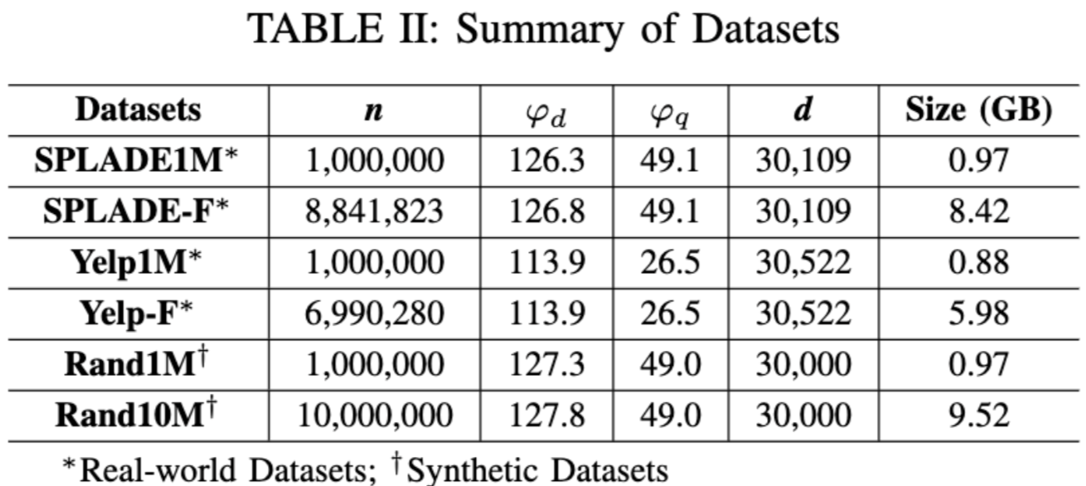

Experimental Results
Datasets
3 Competitors: Inverted file based methods: WAND [1] and SINNAMON [2]; Graph based method: HNSW [3]
Metrics: Recall, TP (throughput)
$Recall=\frac{|R∩R^{∗}|}{|R^{∗}|}$
[1] A. Z. Broder, D. Carmel, M. Herscovici, A. Soffer, and J. Y. Zien. Efficient query evaluation using a two-level retrieval process. In CIKM, pages 426–434. ACM, 2003.
[2] S. Bruch, F. M. Nardini, A. Ingber, and E. Liberty. An approximate algorithm for maximum inner product search over streaming sparse vectors. CoRR, abs/2301.10622, 2023.
[3] Y. A. Malkov and D. A. Yashunin. Efficient and robust approximate nearest neighbor search using hierarchical navigable small world graphs. IEEE Trans. Pattern Anal. Mach. Intell., 42(4):824–836, 2020.
Notes:
To demonstrate the performance of SOSIS, we compare it with 3 baselines on 6 datasets.
The first two baselines is the inverted file based methods that are designed for sparse vectors. The last baseline, HNSW, is designed for dense vectors. We compare SOSIA with it to demonstrate it is not a good choice to consider the sparse vectors same as the dense vectors.
The evaluated metric we use is recall and throughput. The first refers to the query accuracy. The second one refers to the query efficiency.

Slide 10
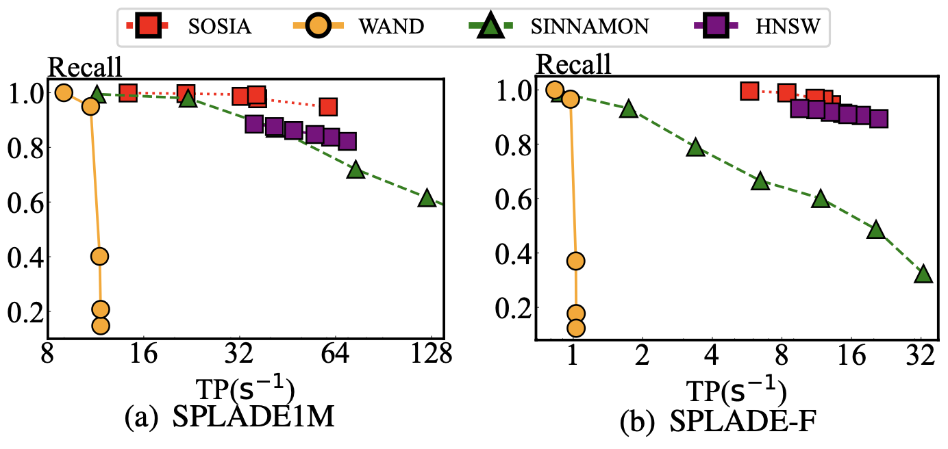
Query Performance
The recall of SOSIA is close to 1
The throughput of SOSIA is the highest to reach the same recall
Notes:
To compare the query performance, we consider the balance between the recall and throughput. To reach the same recall, the algorithm that has the highest throughput achieves the best query performance. From the figure we can see that SOSIA has the highest throughput to reach the same recall, which means it achieves the best query performance.

Slide 11
Summary
We develop the SOS transformation that converts the MIPS problem over sparse vector into set similarity search. The overlap similarity of two points in the transformed space is an unbiased and bounded estimator of their original inner product.
We build minHash indexes over the SOS transformation and propose counting based strategy for efficiently estimating the overlap similarity of two points in the transformed space.
SOSIA achieves the highest query performance theoretically and experimentally compared to the baselines.
Notes:
So, in summary, our method SOSIA accelerates the AMIPS problem over sparse vectors by converting this problem into the set similarity search. Because there are many well-designed algorithm that can be used for quickly answer set similarity problem.
In addition, we design an improvement when answering the set similarity problem.

Slide 12
Thank you!
Q&A

